Slide 1
Chapter 3
Data Types, Variables and Arrays

Slide 2
Java Is a Strongly Typed Language
First, every variable has a type, every expression has a type, and every type is strictly defined.
Second, all assignments, whether explicit or via parameter passing in method calls, are checked for type compatibility.

Slide 3
Primitive Data Types
Eight primitive types of data: byte, short, int, long, char, float, double, and boolean
Put in four groups:
Integers: includes byte, short, int, and long
Floating-point numbers: includes float and double
Characters: includes char
Boolean: includes boolean
Java is completely object oriented but primitive types are not

Slide 4
Primitive Data Types
C and C++ allow the size of an integer to vary based upon the dictates of the execution environment
However, Java is different. Because of Java’s portability requirement, all data types have a strictly defined range for ex int is always 32 bits

Slide 5
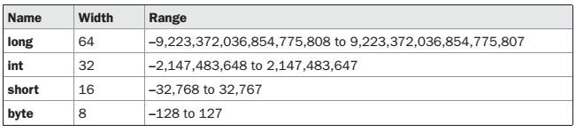
Integer
All of these are signed, positive and negative values.
Java does not support unsigned, positive-only integers
However, Java is different. Because of Java’s portability requirement, all data types have a strictly defined range for ex int is always 32 bits

Slide 6
Integer → byte
Variables of type byte are especially useful when you’re working with a stream of data from a network or file.
They are also useful when you’re working with raw binary data that may not be directly compatible with Java’s other built-in types.
Ex: byte b, c;

Slide 7
Integer → short
It is probably the least-used Java type.
Ex.: short s;

Slide 8
Integer → int
most commonly used
In addition to other uses, variables of type int are commonly employed to control loops and to index arrays.
byte and short values are used in an expression they are promoted to int when the expression is evaluated → ?
Ex.: int s;

Slide 9
Integer →long
It is useful for those occasions where an int type is not large enough to hold the desired value.
Ex: long days;

Slide 10

Floating-Point Types
Also known as real numbers
Two kinds of floating-point types, float and double, which represent single- and double-precision numbers, respectively

Slide 11
Floating-Point Types → float
The type float specifies a single-precision value that uses 32 bits of storage. Single precision is
faster on some processors and takes half as much space as double precision.
Ex: float temp;

Slide 12
Floating-Point Types → double
Require more accuracy
Ex: double pi=3.1416;

Slide 13
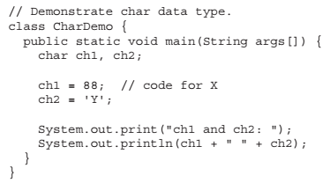
Characters
In C/C++, char is 8 bits wide
Java uses Unicode to represent characters
Unicode defines a fully international character set that can represent all of the characters found in all human languages
Java char is a 16-bit type
No negative char. Range from 0 to 65536

Slide 14
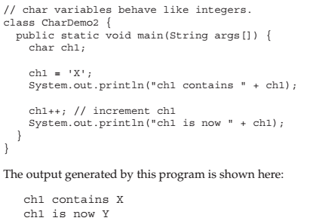
Characters

Slide 15
Booleans
Java has a primitive type, called boolean, for logical values.
Two values, true or false
This is the type returned by all relational operators, as in the case of a < b.

Slide 16
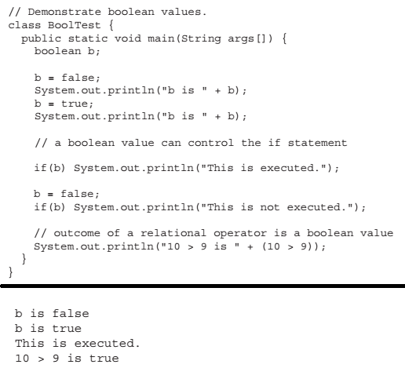

Slide 17
Literals
_{Integer literals : 1,2,3,5,7…,}
_{Octal – leading 0 eg 04}
_{Hex – leading 0x eg 0x10}
It is possible to assign an integer literal to one of Java’s other integer types, such as byte or long as long as it is within range
_{Floating point literals :}
Standard notation – 2.0, 3.14234, 0.54334
Scientific notation - 3.0544E12, 314234E-5
Floating-point literals in Java default to double precision.

Slide 18
Literals
Boolean literals :
The values of true and false do not convert into any numerical representation
Character literals:
Unicode characters enclosed in single quote. ‘X’, ‘\n’, ’\’, ‘\65’,
For octal notation → ‘\3 digit’ → ‘\141’ = ‘a’
For hexadecimal → ‘\ 4 hex digit’ → \u0061’ ISO-Latin-1 ‘a’
String literals:
“Hello World” , “Double \n lines”, “\”In double quotes\””
One important thing to note about Java strings is that they must begin and end on the same line.

Slide 19
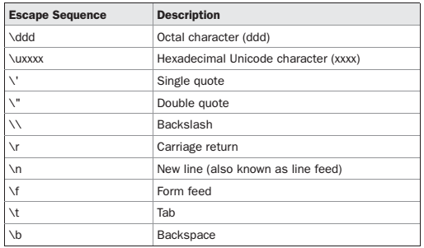
Literals

Slide 20
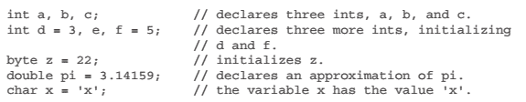
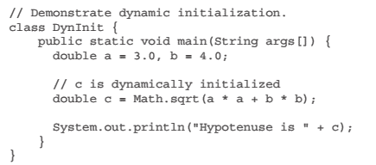
Variables
Declaration
type identifier[ =value][,identifier[=value] ...] ;
Dynamic Initialization

Slide 21
Variables
Scope and lifetime of variable
A block defines the scope of a variable
Java defines two types of scope; Class scope and method scope
Class scope has unique properties and attributes that do not apply to method scope
Variables declared inside a scope are not visible (that is, accessible) to code that is defined outside that scope
variables are created when their scope is entered, and destroyed when their scope is left
Scopes can be nested
Java does not permit using the same name again if a variable is declared in outer scope

Slide 22
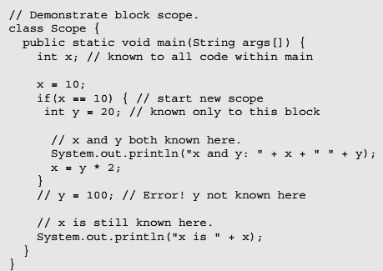
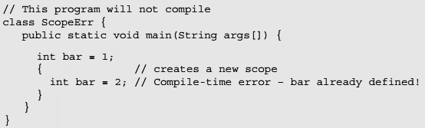
Variables
Scope and lifetime of variable

Slide 23
Type Casting and Conversion
Automatic type conversion (/ Widening conversion) will take place if the following two conditions are met:
The two types are compatible.
The destination type is larger than the source type.
No automatic conversions from the numeric types to char or Boolean
Explicit type casting → Narrowing conversion
When a floating-point value is assigned to an integer type, the fractional component is lost
If the size of the whole number component is too large to fit into the target integer type, then that value will be reduced modulo the target type’s range.

Slide 24
Type Casting and Conversion
Explicit type casting → Narrowing conversion
For example, the following fragment casts an int to a byte. If the integer’s value is larger than the range of a byte, it will be reduced modulo (the remainder of an integer division by the) byte’s range.
int a;
byte b;
// ...
b = (byte) a;
A different type of conversion will occur when a floating-point value is assigned to an integer type: truncation.

Slide 25
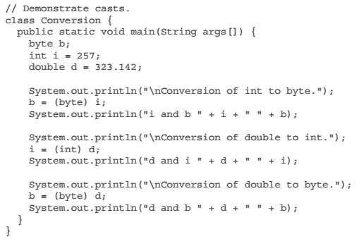
Type Casting and Conversion

Slide 26
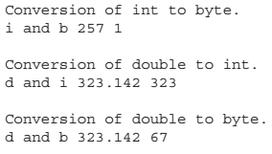
Type Casting and Conversion

Slide 27


Automatic Type Promotion in Expressions
Here a * b exceeds byte range.
Java automatically promotes each byte, short, or char operand to int when evaluating an expression
Incorrect
Correct

Slide 28
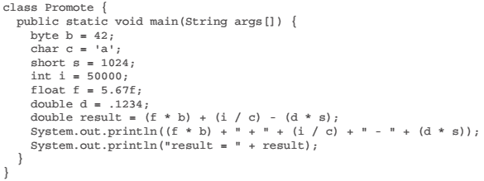
Automatic Type Promotion
First, all byte, short, and char values are promoted to int, as just described. Then, if one operand is a long, the whole expression is promoted to long. If one operand is a float, the entire expression is promoted to float. If any of the operands is double, the result is double.

Slide 29
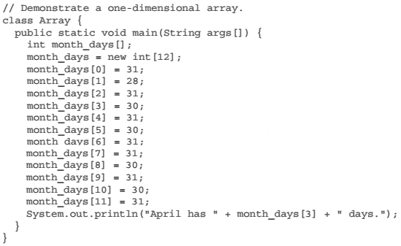
Arrays
One-Dimensional Arrays
type varName[]; - declares an array
varName = new type[size] – allocates memory
Ex: month_day = new int[12]; - all elements initialized to zero

Slide 30
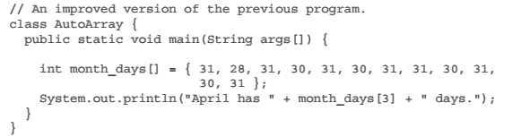
Arrays
Java strictly checks to make sure you do not accidentally try to store or reference values outside of the range of the array.
An array initializer is a list of comma-separated expressions surrounded by curly braces.

Slide 31
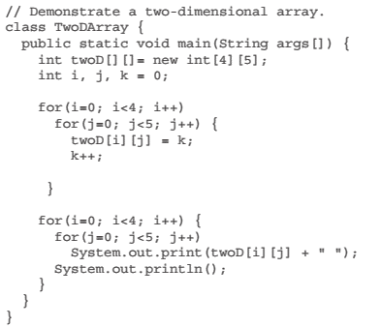
2-D Arrays

Slide 32
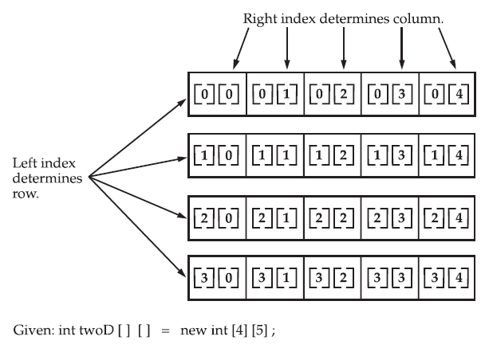
2-D Arrays

Slide 33
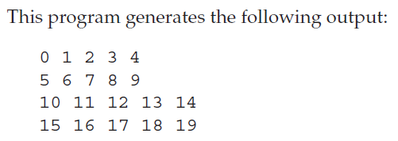
2-D Arrays

Slide 34
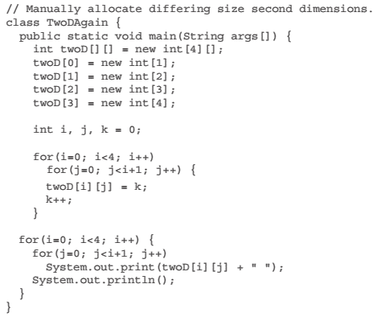
2-D Arrays

Slide 35
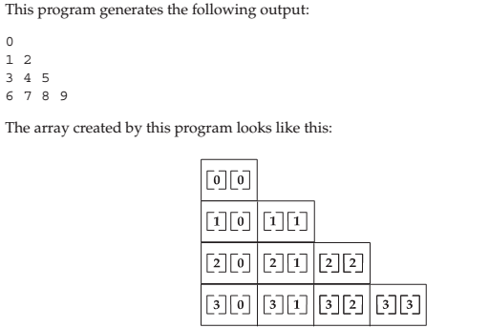
2-D Arrays

Slide 36
2-D Arrays
// Initialize a two-dimensional array.
class Matrix {
public static void main(String args[]) {
double m[][] = {
{ 0*0, 1*0, 2*0, 3*0 },
{ 0*1, 1*1, 2*1, 3*1 },
{ 0*2, 1*2, 2*2, 3*2 },
{ 0*3, 1*3, 2*3, 3*3 }
};
int i, j;
for(i=0; i<4; i++) {
for(j=0; j<4; j++)
System.out.print(m[i][j] + " ");
System.out.println();
}
}

Slide 37
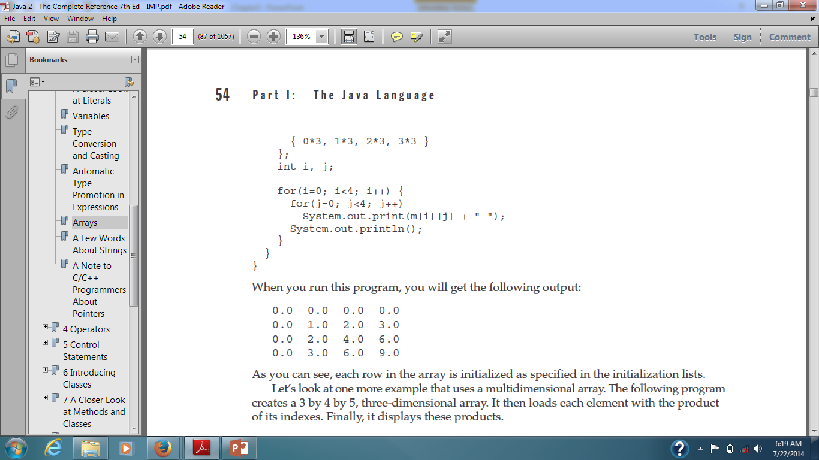
2-D Arrays
// Initialize a two-dimensional array.
class Matrix {
public static void main(String args[]) {
double m[][] = {
{ 0*0, 1*0, 2*0, 3*0 },
{ 0*1, 1*1, 2*1, 3*1 },
{ 0*2, 1*2, 2*2, 3*2 },
{ 0*3, 1*3, 2*3, 3*3 }
};
int i, j;
for(i=0; i<4; i++) {
for(j=0; j<4; j++)
System.out.print(m[i][j] + " ");
System.out.println();
}
}

Slide 38
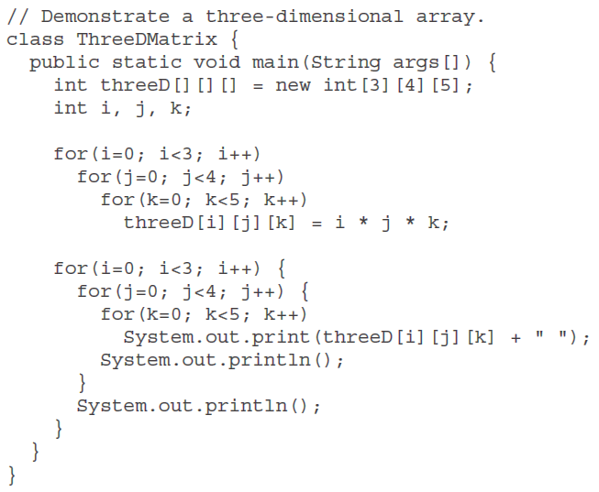
3-D Arrays

Slide 39
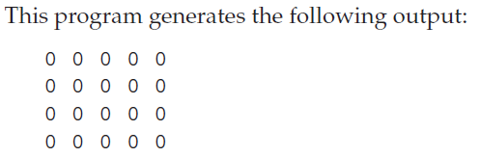
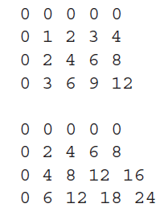
3-D Arrays

Slide 40

Alternative Array declaration
Following statements are equivalent
Similarly
Declaration several arrays same time:
int[] nums1, nums2, nums3; // create three arrays
The alternative declaration form is also useful when specifying an array as a return type for a method.

Slide 41
String
String is not a simple type, neither it is array of char
It defines an object
Similarly
Example:
String str = "this is a test";
System.out.println(str);

Slide 42
A Note to C/C++ Programmers About Pointers
Java does not support or allow pointers.

